Slide 1

Learning To Schedule Sport Tournaments from Tensor Data
Tom De Bièvre

Slide 2
Context
Many real world problems require constraints
Sport scheduling is really complex and laboursome: MLB
  2 leagues
  Each league consists of 3 divisions
  162 games per team per regular season
Could this be automated to lower the amount of work?
DTAI, Department of Computer science
Notes:
20-12-19

Slide 3
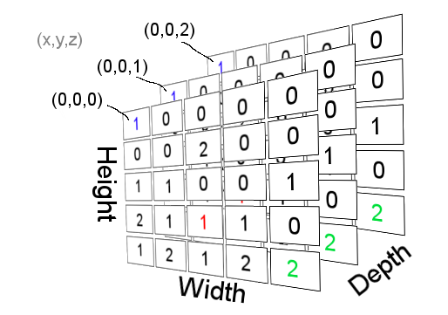
Aim
Use/adapt countOR algorithm with sport scheduling
    Learning/acquiring constraints
    Making sport scheduling easier
DTAI, Department of Computer science

Slide 4
Approach: Literature study
What are sport tournaments? Terminology?
What are sport scheduling constraints? Commonly used?
Mathematical context of constraints
Other algorithms specifically used to generate schedules
Constraint Learning solutions
DTAI, Department of Computer science

Slide 5
Approach: Relevant literature
Mohit Kumar, Stefano Teso, and Luc De Raedt. “Automating Personnel Rostering by Learning Constraints Using Tensors”. In: (2018)
Krzysztof Apt. “Principles of Constraint Programming”. In: Principles of Constraint Programming (2003).
Nicolas Beldiceanu and Helmut Simonis. “A Model Seeker : Extracting Global Constraint Models From Positive Examples”
Rasmus V. Rasmussen and Michael A. Trick. “Round robin scheduling – a survey”. In: European Journal of Operational Research188.3 (2008)
Kimmo Nurmi et al. “A framework for scheduling professional sports leagues”. In: AIP Conference Proceedings 1285.May 2014 (2010)
Christian Bessiere. Constraint Propagation, Tech. rep. March. CNRS/University of Montpellier, 2002
DTAI, Department of Computer science
Notes:
20-12-19

Slide 6
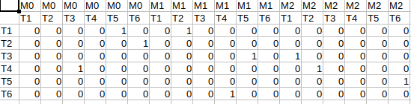
Approach: CountOR
Model schedules in tensors
Applying tensor operations to achieve quantities of interest
  Summing
  Maximizing
Applied in nurse rostering
What can we learn from countOR as is?
DTAI, Department of Computer science
Notes:
20-12-19

Slide 7
Practical approach: Experimental pipeline
Generate a set of solutions for the Sport Scheduling Problem
Learn an estimated model M from [1,10,25,50] solutions
Generate many samples based on M
Calculate Recall and precision based on the samples

Slide 8
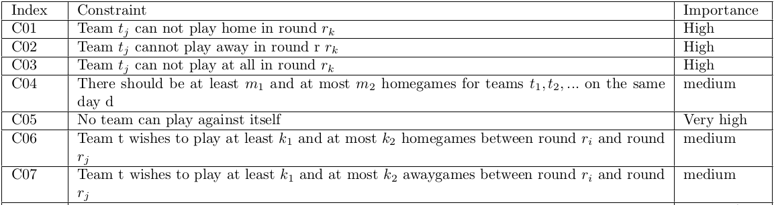
Practical approach: CountOR(benchmark)
Generate set of Solutions for the SSP
DTAI, Department of Computer science

Slide 9
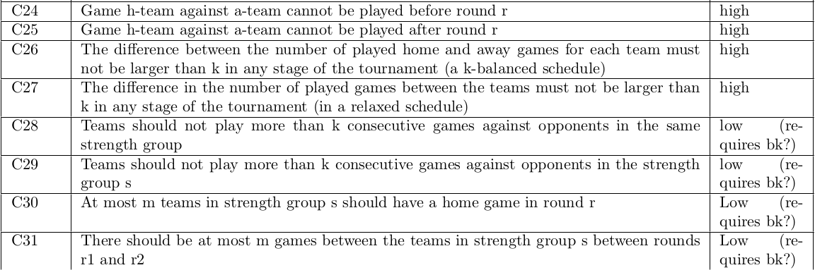
Practical approach: CountOR(benchmark)
DTAI, Department of Computer science

Slide 10
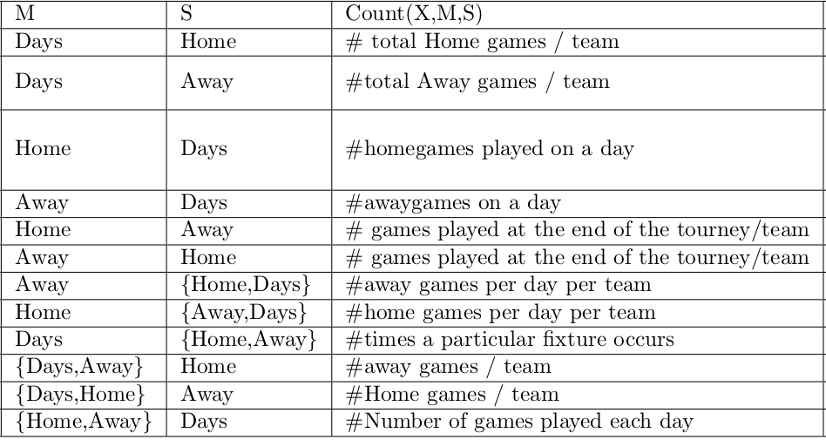
Approach: CountOR
DTAI, Department of Computer science
Notes:
20-12-19

Slide 11
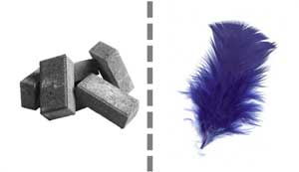
Practical approach: CountSPORT
Validation of models
  Hard constraints
  Soft constraints?

Slide 12
CountSPORT: Planning
Extension of the countOR algorithm
New aggregation functions
Capture constraints
  Priority based capture based on relevance
Experimental pipeline remains the same
DTAI, Department of Computer science

Slide 13

DTAI, Department of Computer science

